Slide 1
Let’s Build our own layout

Slide 2

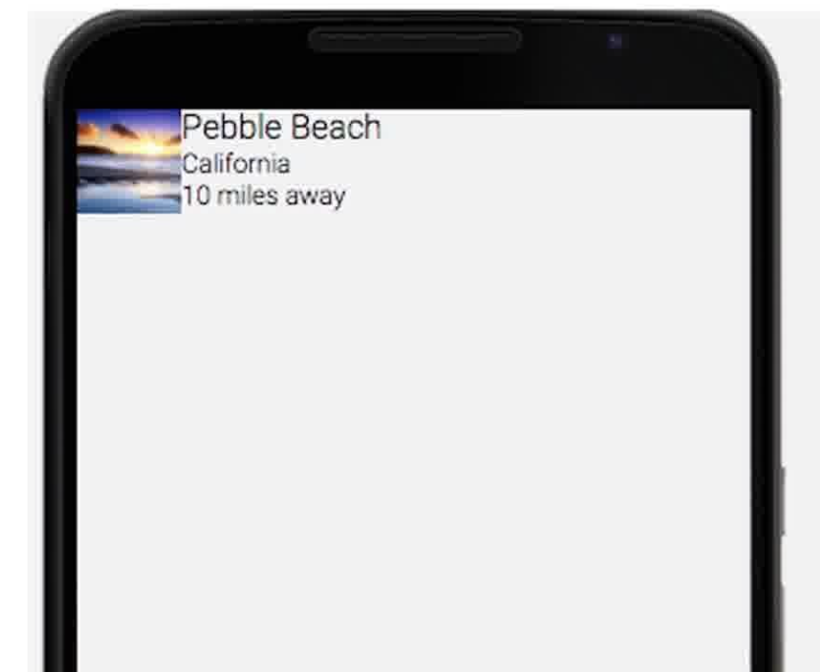
Modify to suit our requirements
https://gist.github.com/khkred/bb7c126bf067eeed0293f23a25efb562

Slide 3
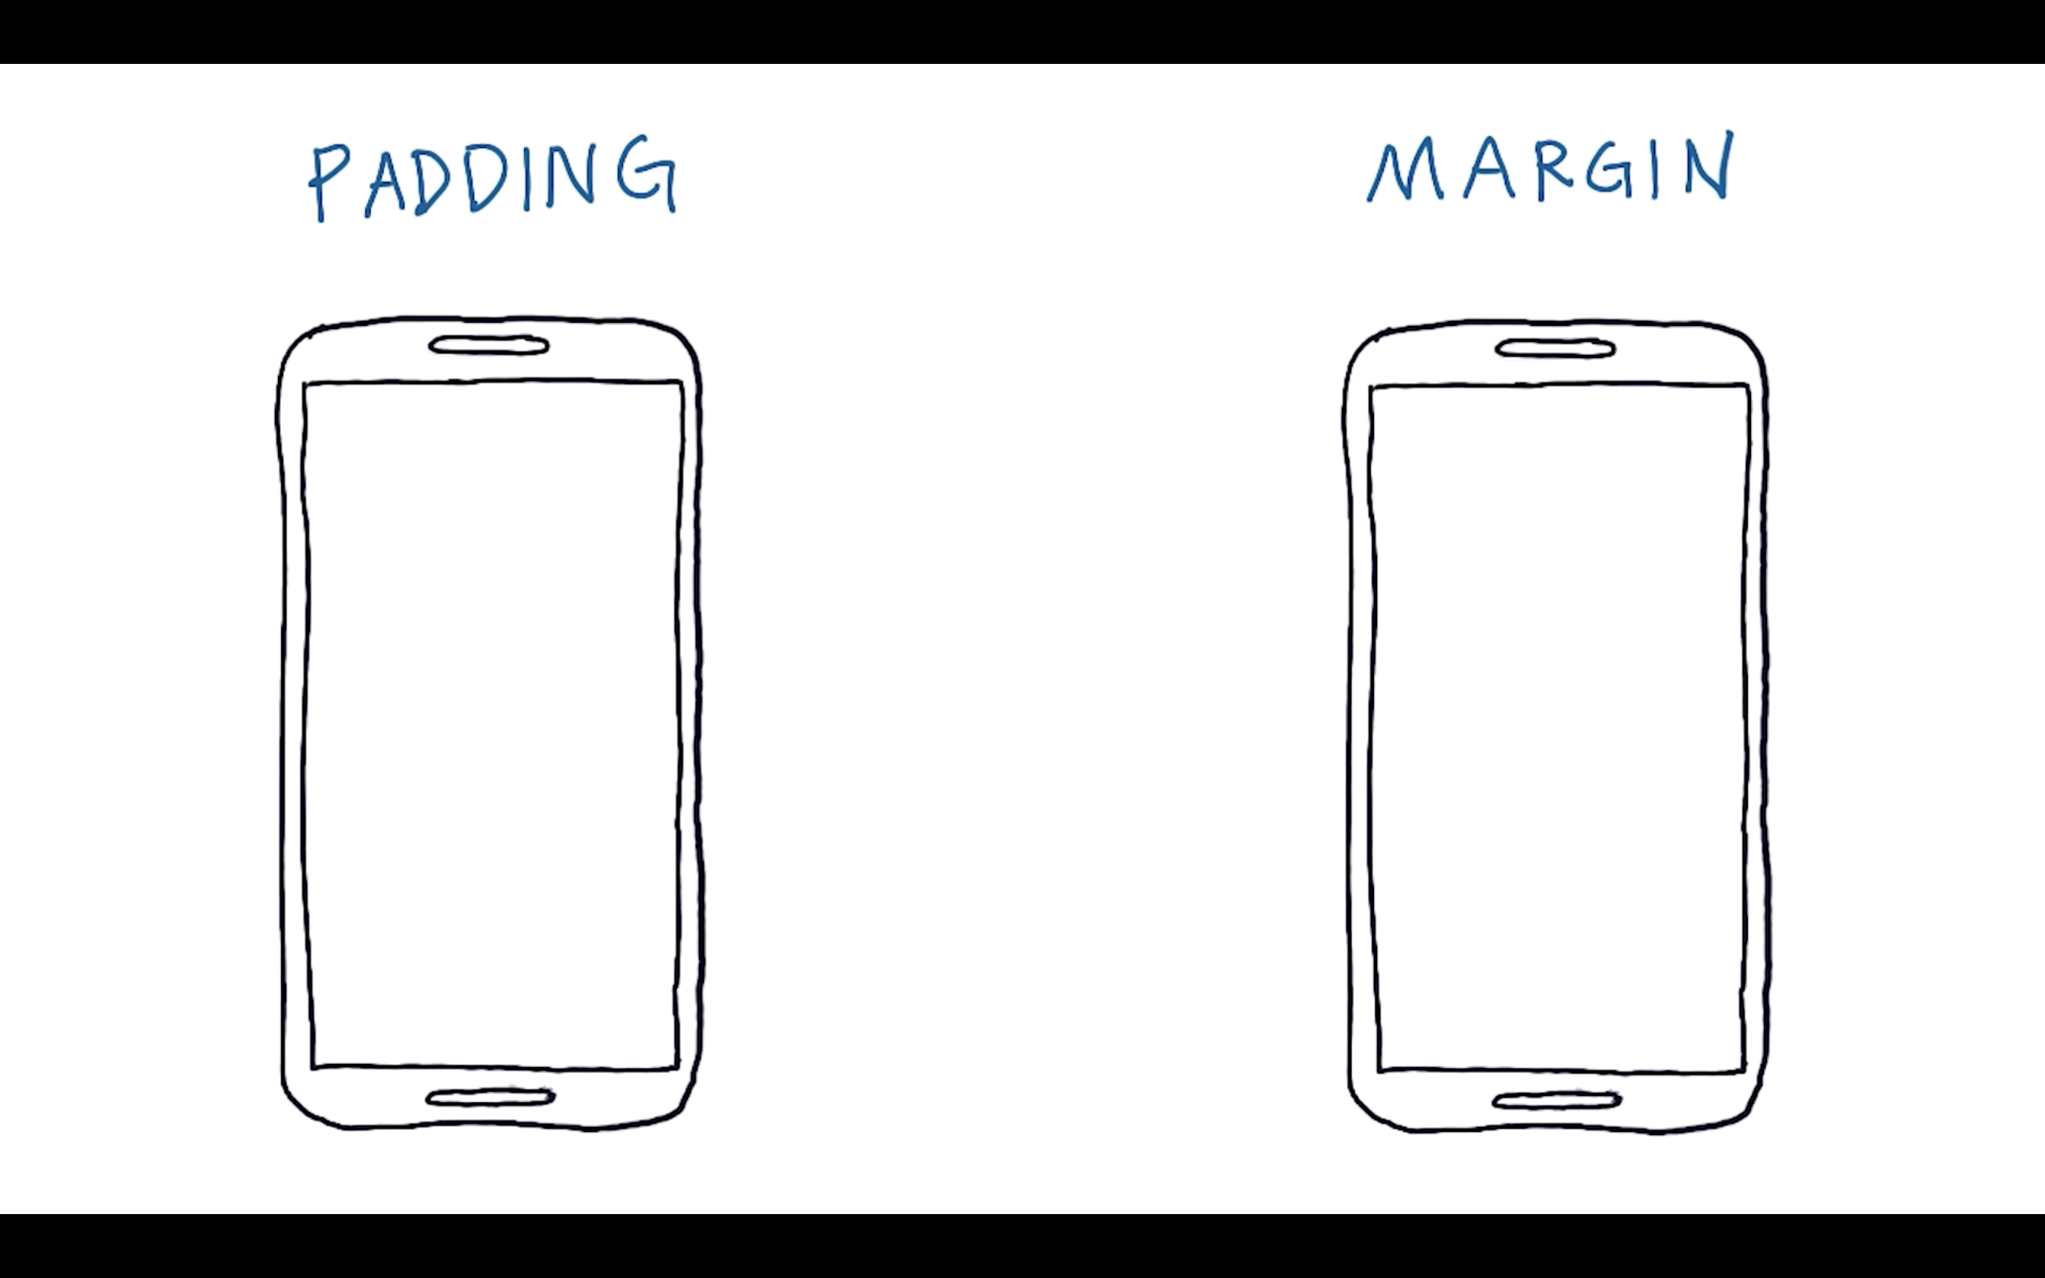

Slide 4
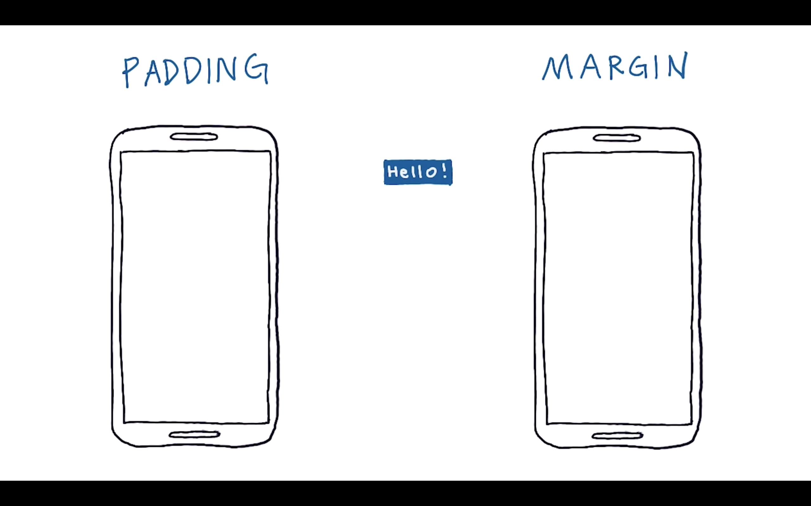

Slide 5
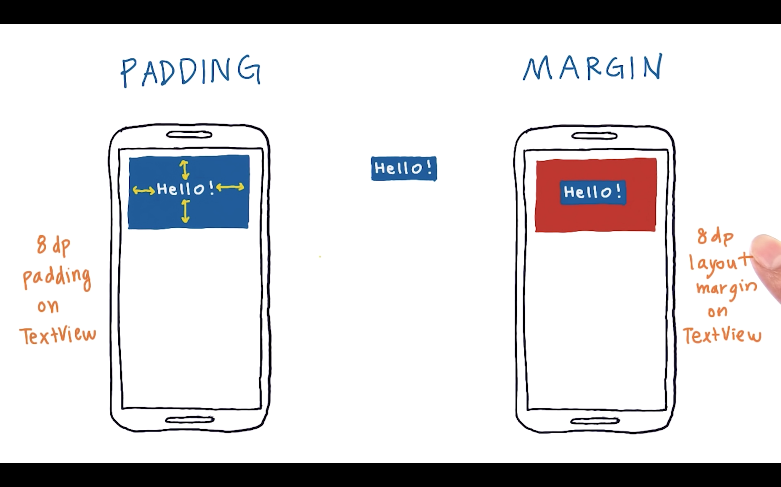

Slide 6
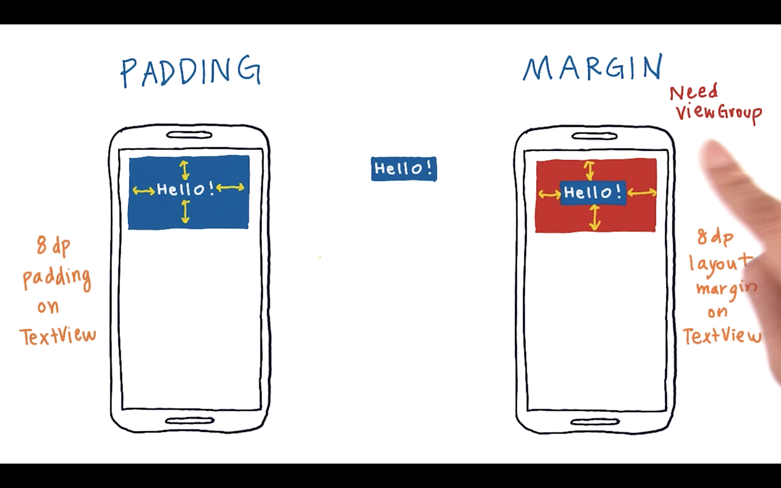

Slide 7
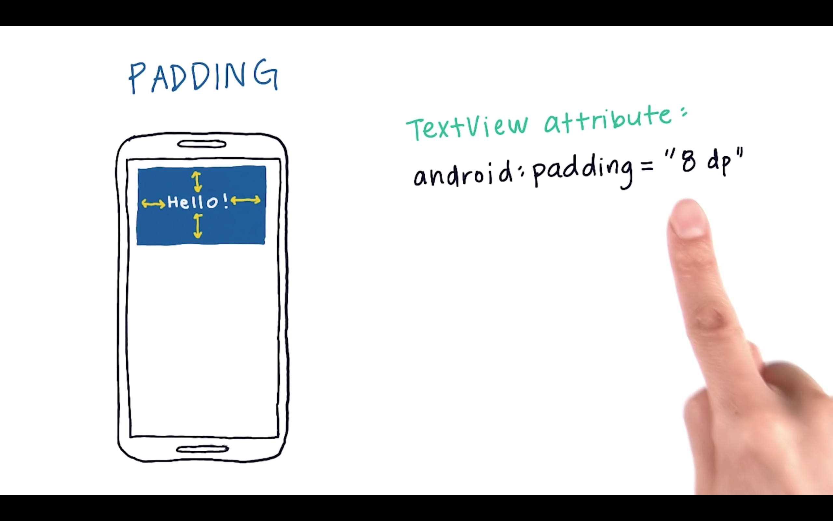

Slide 8
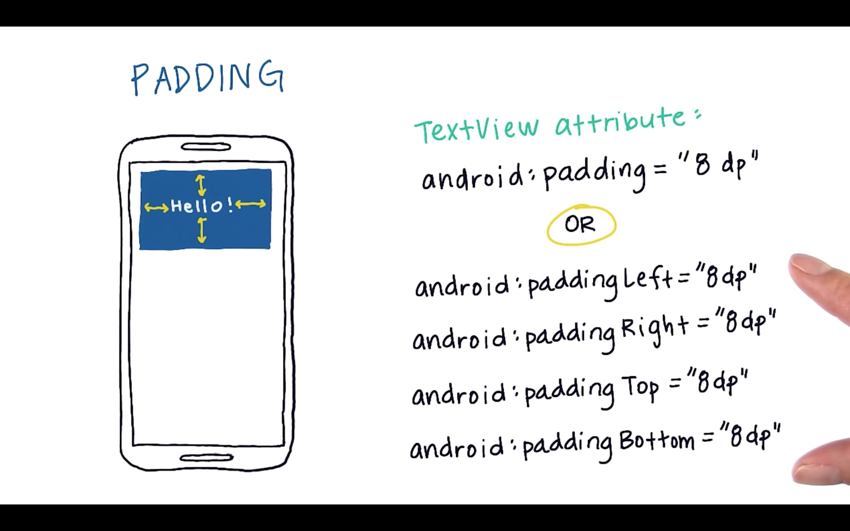

Slide 9
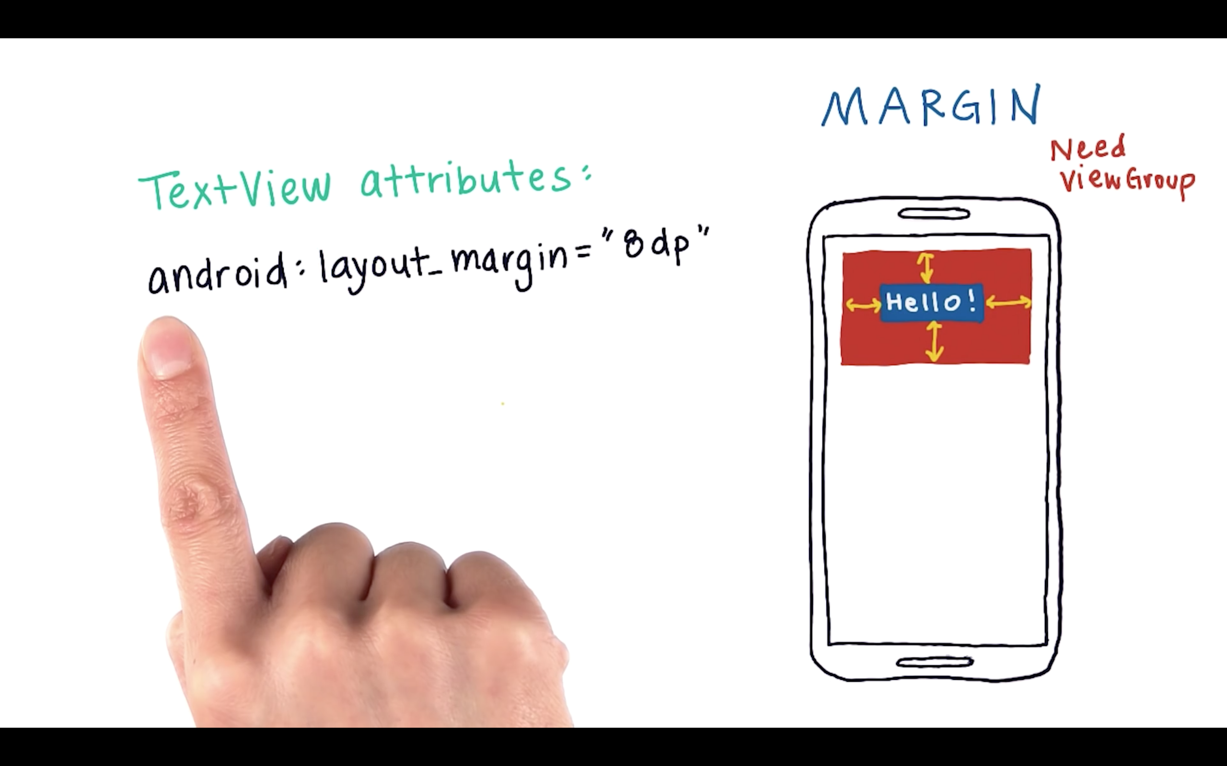

Slide 10
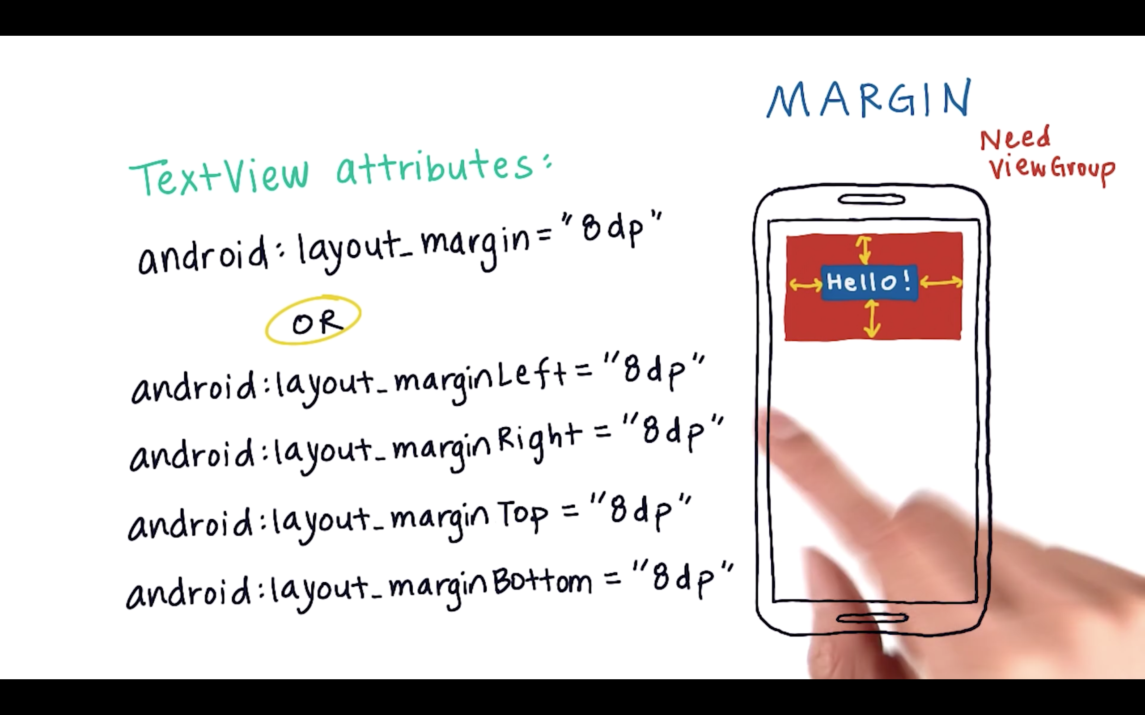

Slide 11
Interview with a Google Developer -2

